Slide 1
The Liberec Region
Home of Crystal Valley, innovations
and nanotechnology
@Libereckykraj
Liberecký kraj

Slide 2
The Liberec Region
is situated on the north of the Czech Republic in the Middle Europe.
- 20 km state border with Germany, 130 km long border with Poland,
- 3.163 km², 437.570 inhabitants,
- the Capital City Liberec is the university town, known for nanotechnology
research.
The glass and jewellery industry known as Crystal Valley, the production and processing of plastics, engineering and processing industries are primarily developer, with close ties to the production of cars.
The Region has rich historical and cultural tradition and many sports and touristic facilities.
The Liberec Region

Slide 3
Smart Accelerator of Liberec Region R&D Support
The Liberec Region belongs to the European leaders in the following areas:
Nanomaterials: close cooperation between nanotechnology companies and the Technical university of Liberec, where the industrial production of nanofibres was born (Nanospider machine)
Optoelectronics and optics for scientific instruments and satellites (Toptec Co. and Crytur Co.)
Glass industry (Crystal Valley: crystalvalley.cz)
Advanced mechanical engineering (VUTS)
More information and contact: 1012plus.cz
How can we help you SMART?
Networking and matchmaking with foreign partners in the form of companies,
universities and research teams
Cooperation on international events and projects
The European Digital Innovation Hub operates here to support the digitization of SMEs
The Liberec Region

Slide 4
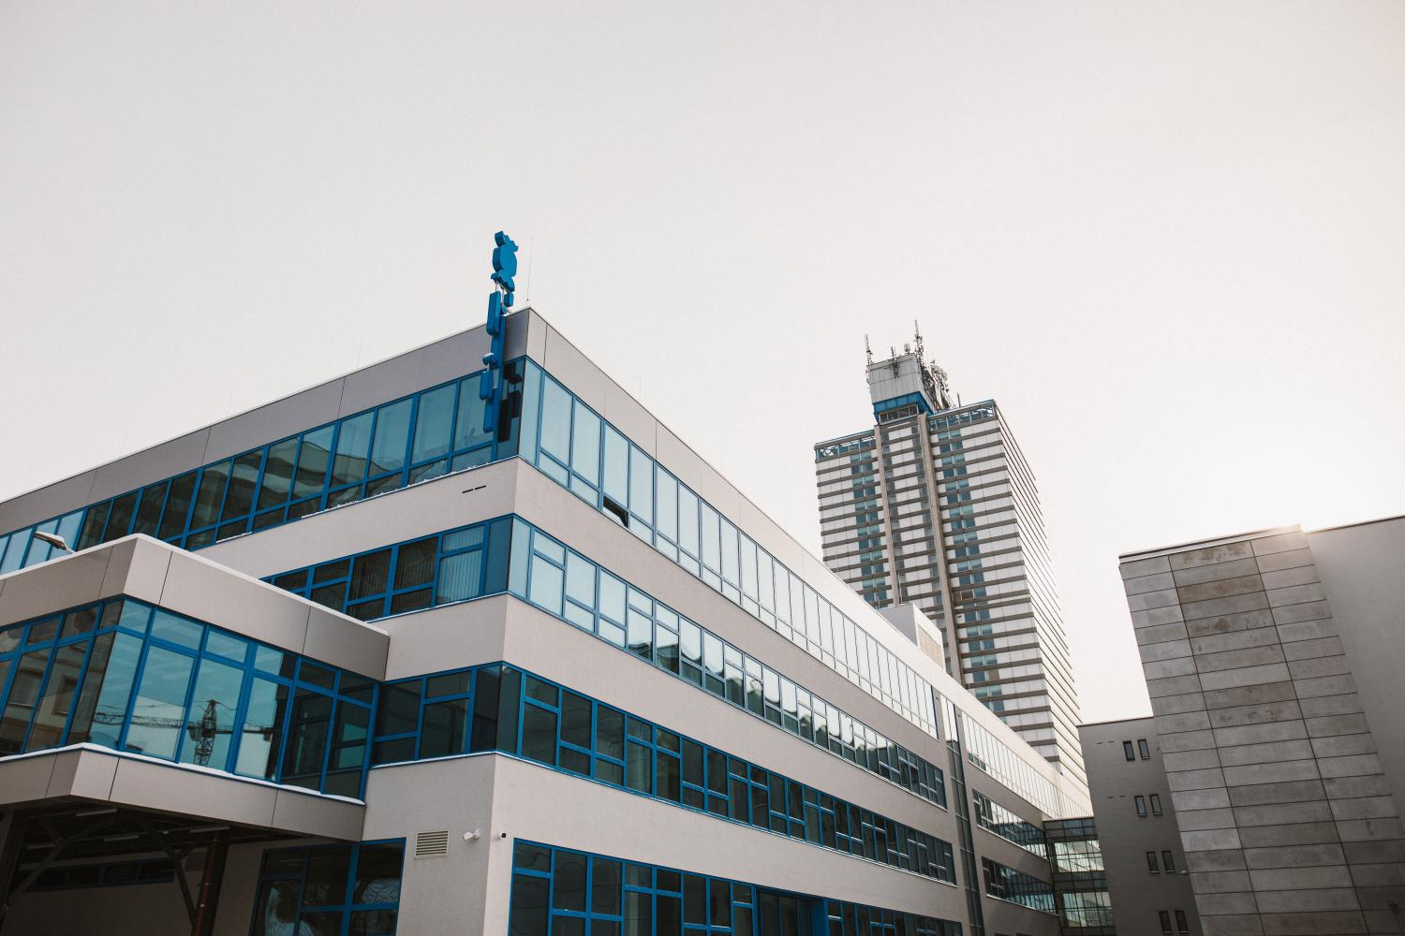
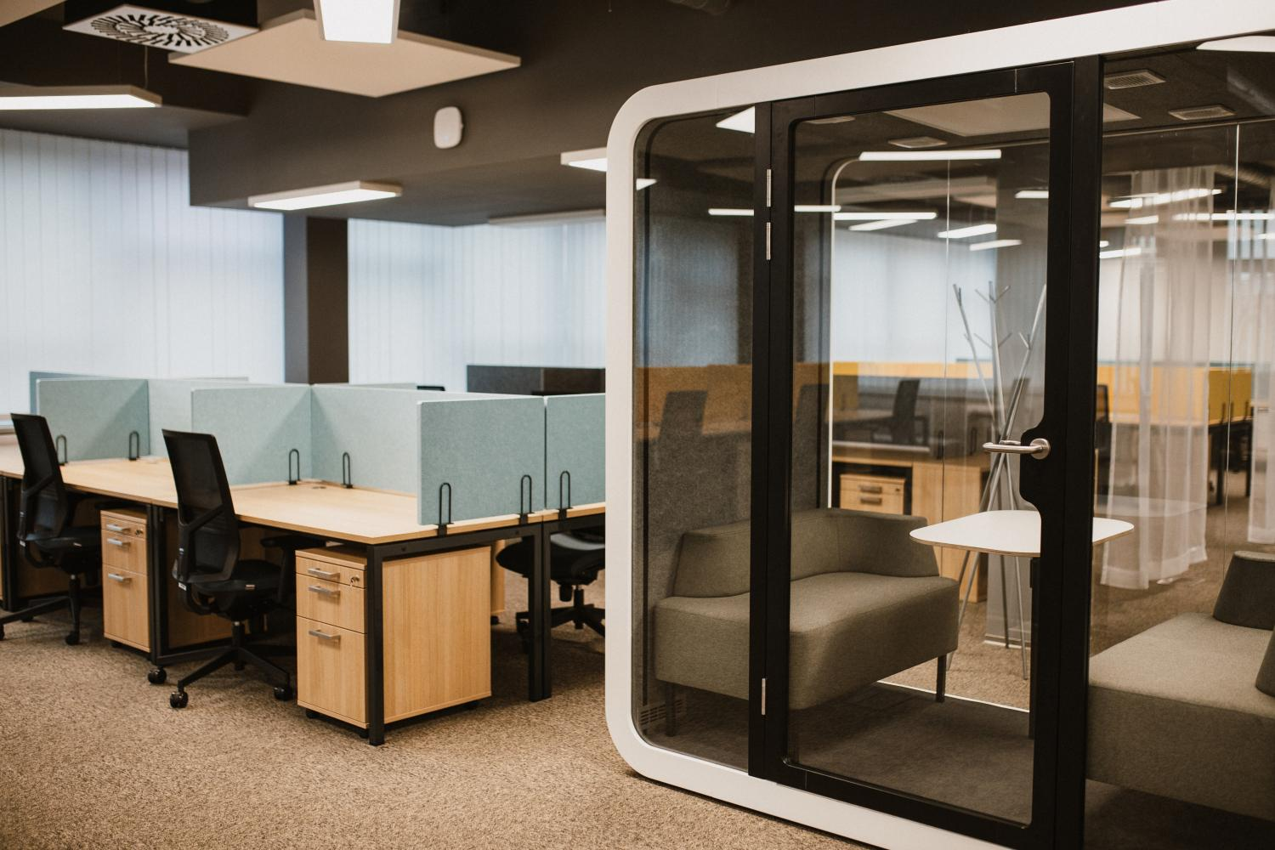
Lipo.ink-our business incubator
Support for the small and medium sized or the brand new firms from the region.
Help through the The PlatInn business and innovation program originates from Switzerland to grow and innovate.
Founding member of the first nationwide network of innovation centers YNOVATE, which can lead innovative, ambitious, and sustainable businesses.
Clients mainly from Internet of Things, Virtual Reality, Artificial Intelligence.
Clients with the foreign business partners are helped with listing on the stock exchange (Hardwario Co., Statotest Co.).
The Liberec Region

Slide 5
investujpodjestedem.cz
Web sites providing by The Liberec Region with all the information for the investors (FAQ, offers, consultation, support).
Brownfields a greenfields database (approx. 260 locations).
The Liberec Region

Slide 6
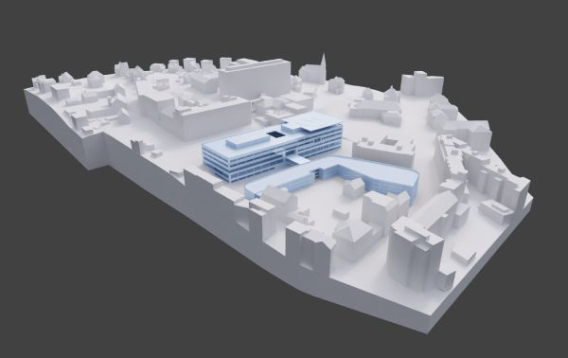
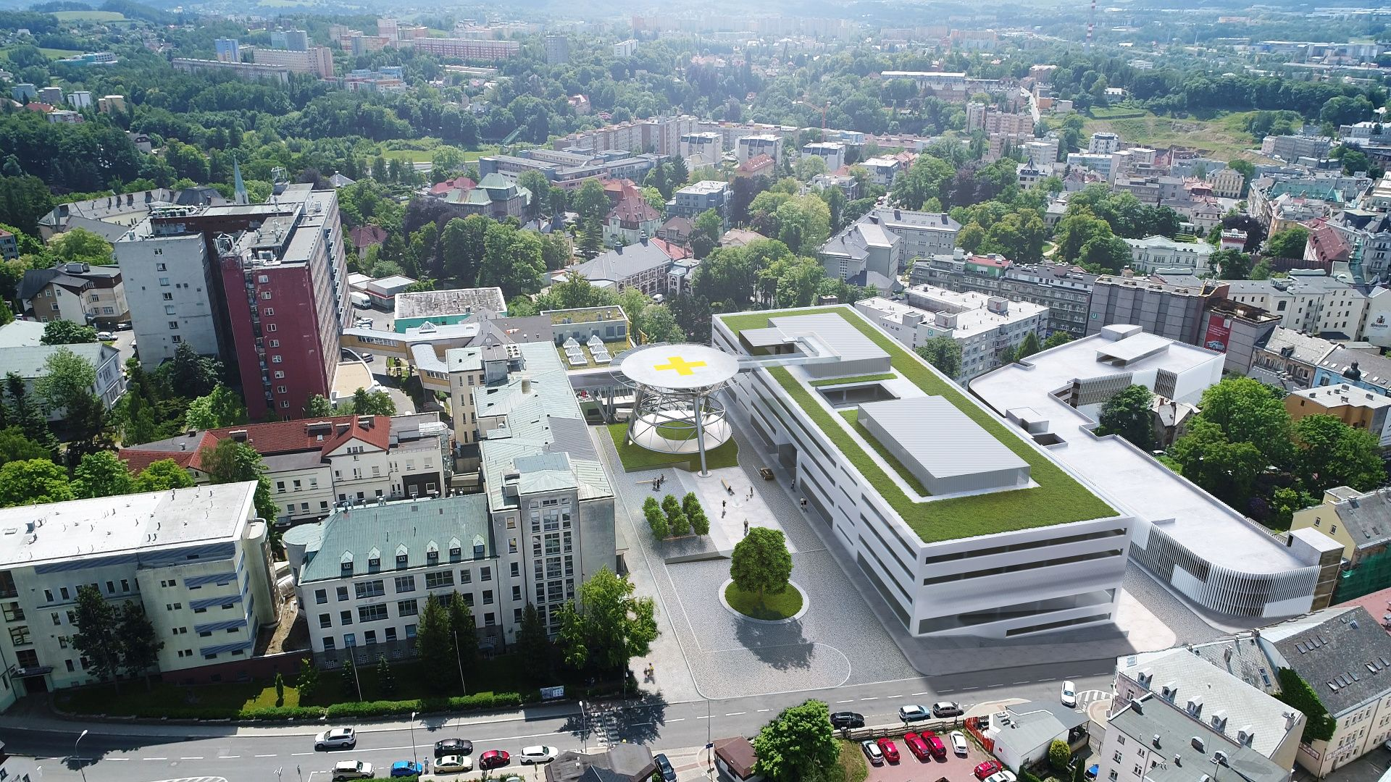
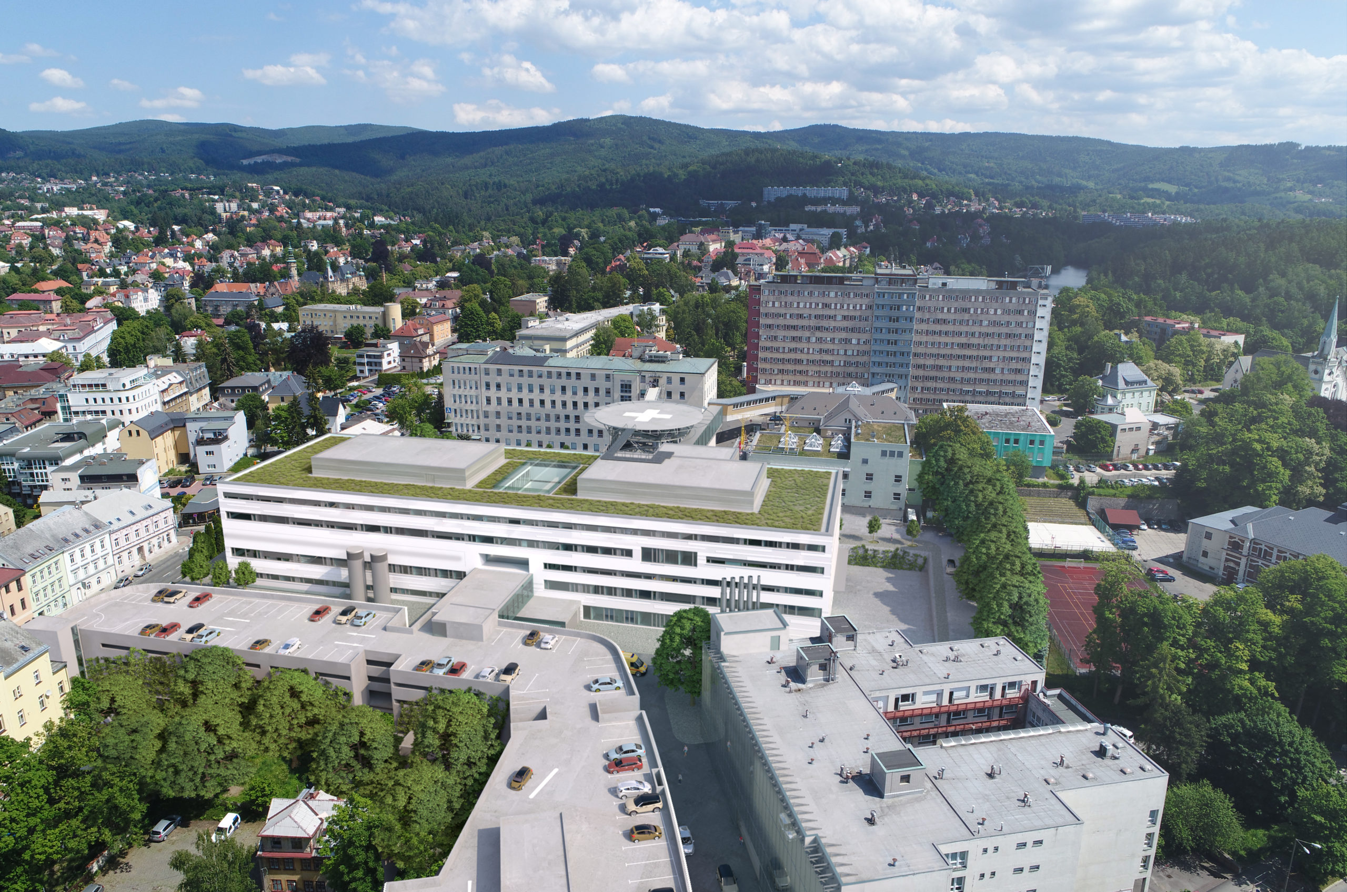
Healthcare Resort
The priority of the regional health service is the Hospital Modernization Project. The modern hospital, which provides the high-quality medical care for the needs of the residents not only from the Liberec Region.
Emergency Medical Center – effectively shared area of ​​emergency, complex diagnostics, inpatient areas (intensive care and resuscitation beds, beds of super-specialized workplaces, such as Cardiocenter, Comprehensive Oncology Center, Traumatology-Orthopedic Center, Cerebrovascular Center).
The Liberec Region

Slide 7
The Liberec Region

Slide 8
Thank you

